Slide 1
The cohort analysis and key insights
from EDA and data quality analysis
Nekky L.

Slide 2
The main directions: Frequency of Service Usage. Incident Rate Revenue Generated by the Cohort New Relevant Metric (next possible study)

Slide 3
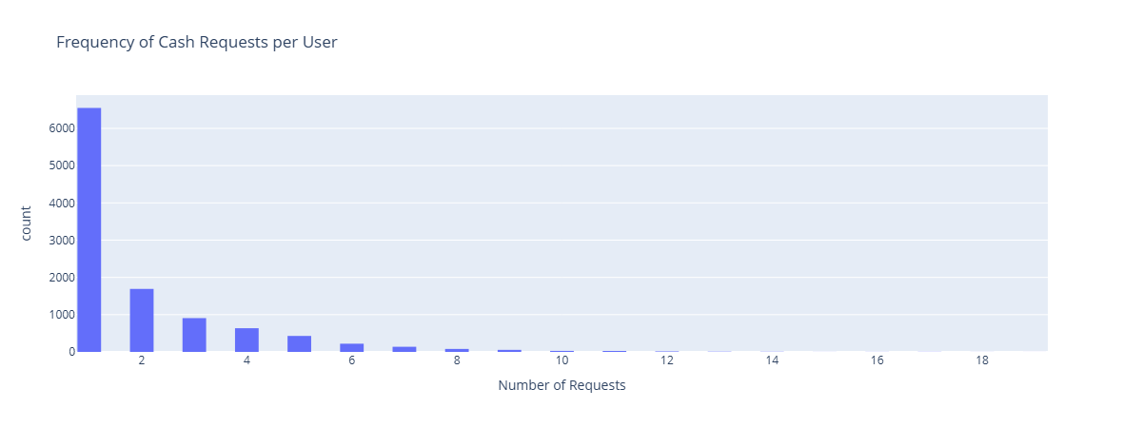
Repeatedness of User IDs: The majority of users only request cash once (some users have multiple requests.) Other frequent users have made between 16 and 19 requests. This indicates that there are a few highly frequent users (potentially power users)
Frequency of Service Usage:
The user_id variable around 31,808.

Slide 4
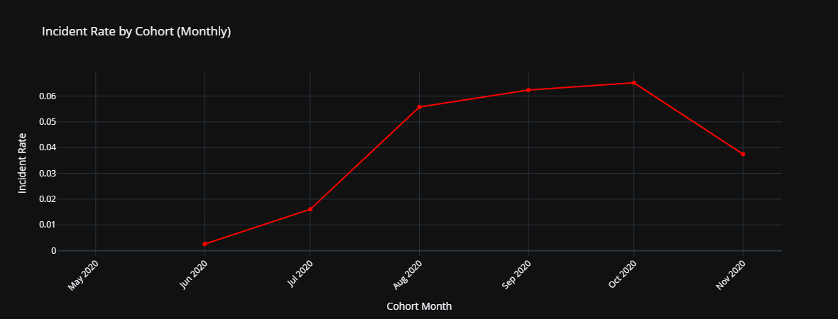
Incident Rate Over Time:
The incident rate shows a steady increase over the months, with a noticeable jump starting from September 2020.
The incident rate in May 2020 is relatively low (around 0.26%),
but it rises sharply in subsequent months, peaking at 6.23% in September 2020.

Slide 5
Incident Rate:
Insights:
There are variations in incident rates across cohorts, suggesting that payment incidents
(e.g., rejected requests) become more frequent as time progresses.
The rise in incidents may indicate changes in user behavior, system errors, or other external factors that affect payment acceptance.

Slide 6
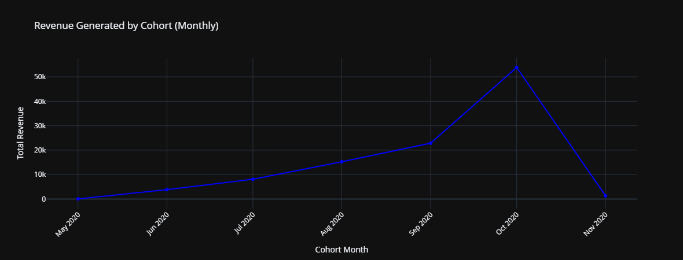
Revenue Generated by Each Cohort are:
created_at: To determine the cohort (based on the month).
total_amount: To calculate the total revenue.

Slide 7
Graph Overview:
X-Axis cohort months:
a specific month when users first interacted with the service.
Y-Axis total revenue :
reflect the sum of total_amount for all users in that cohort.
The higher the value, the more revenue was generated in that cohort

Slide 8
Insights
Revenue Growth:
If revenue increases steadily, it indicates growth in the user base or transaction volume.
Fluctuations : like promotions, market changes, or seasonality.
Cohort Performance ,High Revenue Cohorts: stronger revenue, reflecting higher user engagement or spending.
Seasonality: spikes at certain times of year (e.g., holidays) , seasonal trends, helping with forecasting and resource planning.

Slide 9
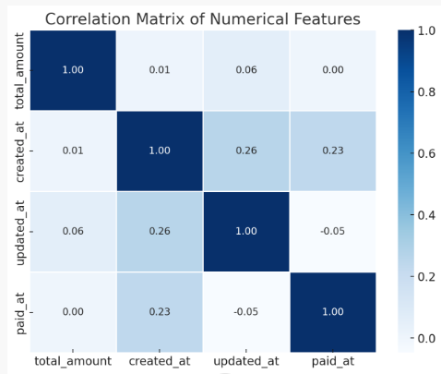
New Relevant Metric (next possible study)
New Assumption: the longer time duration,
the lower desire in using the service
To see the time duration of
the administration(annoying process) ,
manual examination (waiting time),
Using the Service
(old customers, substitution from market)

Slide 10
Thank you

